Slide 1
Agricultural Inventory Update – March 31, 2021

Slide 2
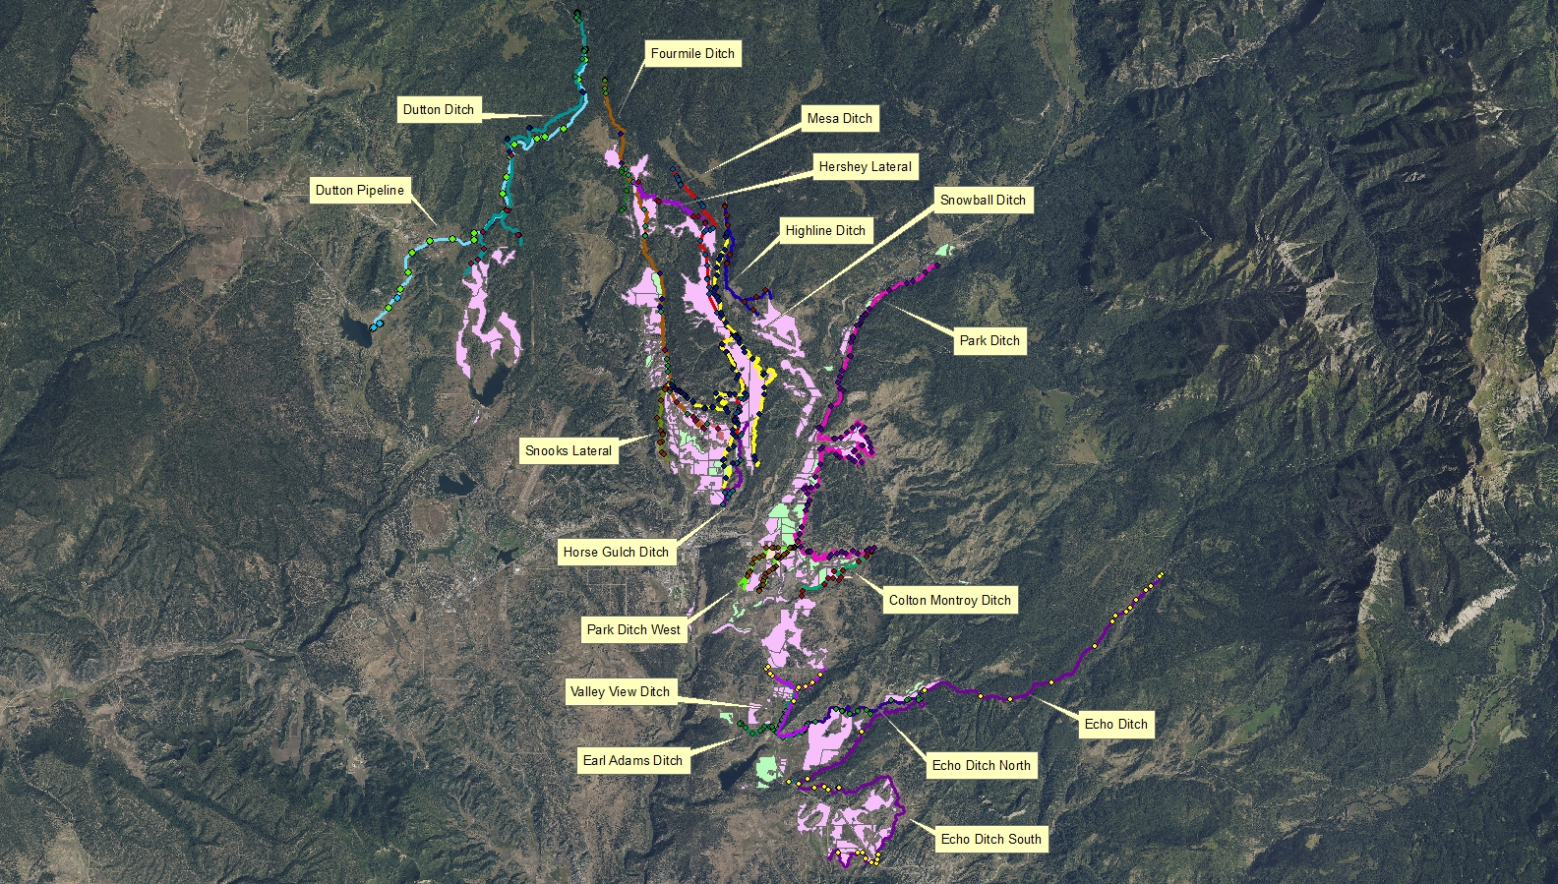

Slide 3
Inventoried Ditch Length, Miles (Approximate)
Echo Ditches 12.9
Earl Adams Ditch 1.9
Valley View Ditch 2.9
Mesa Ditch 6.1
Park Ditch 12.8
Snowball Ditch 6.2
Fourmile Ditch 8.5
Horse Gulch Ditch 2.3
Dutton Ditch 8.1
Highline Ditch 3.0
Snooks Lateral 1.7
Colton Montroy 2.0
Hershey Lateral 2.1
Hidden Valley 0.9
TOTAL: 71.4 miles
Structure/Inventory Points
Echo, Echo North and Echo South Ditches 49
Earl Adams Ditch 29
Valley View 11
Mesa Ditch 70
Park Ditch 133
Snowball Ditch 90
Fourmile Ditch 39
Horse Gulch Ditch 11
Dutton Ditch 25
Highline Ditch 12
Snooks Lateral 13
Colton Montroy Ditch 14
Hershey Lateral 7
Hidden Valley 5
TOTAL STRUCTURES/POINTS: 508

Slide 4
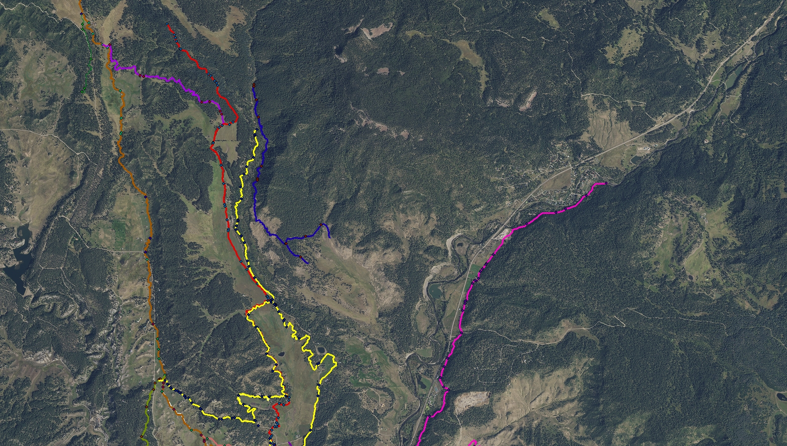

Slide 5
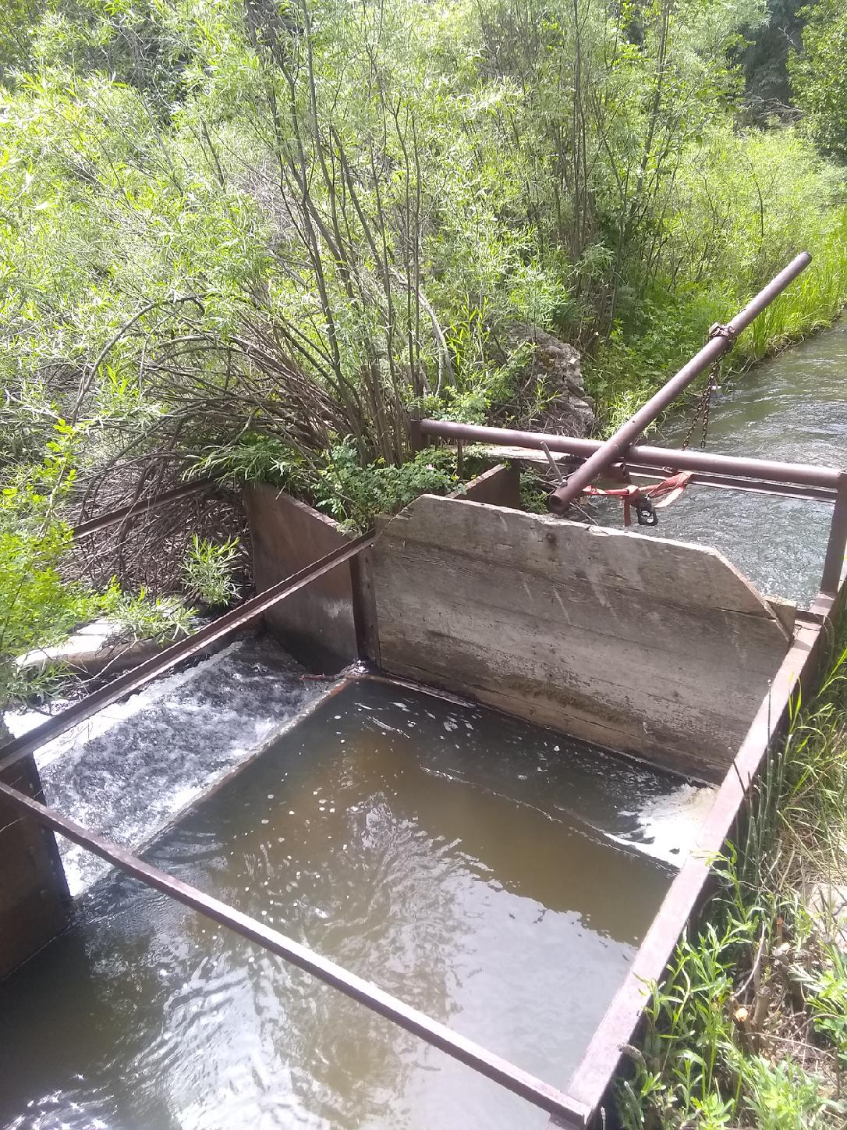
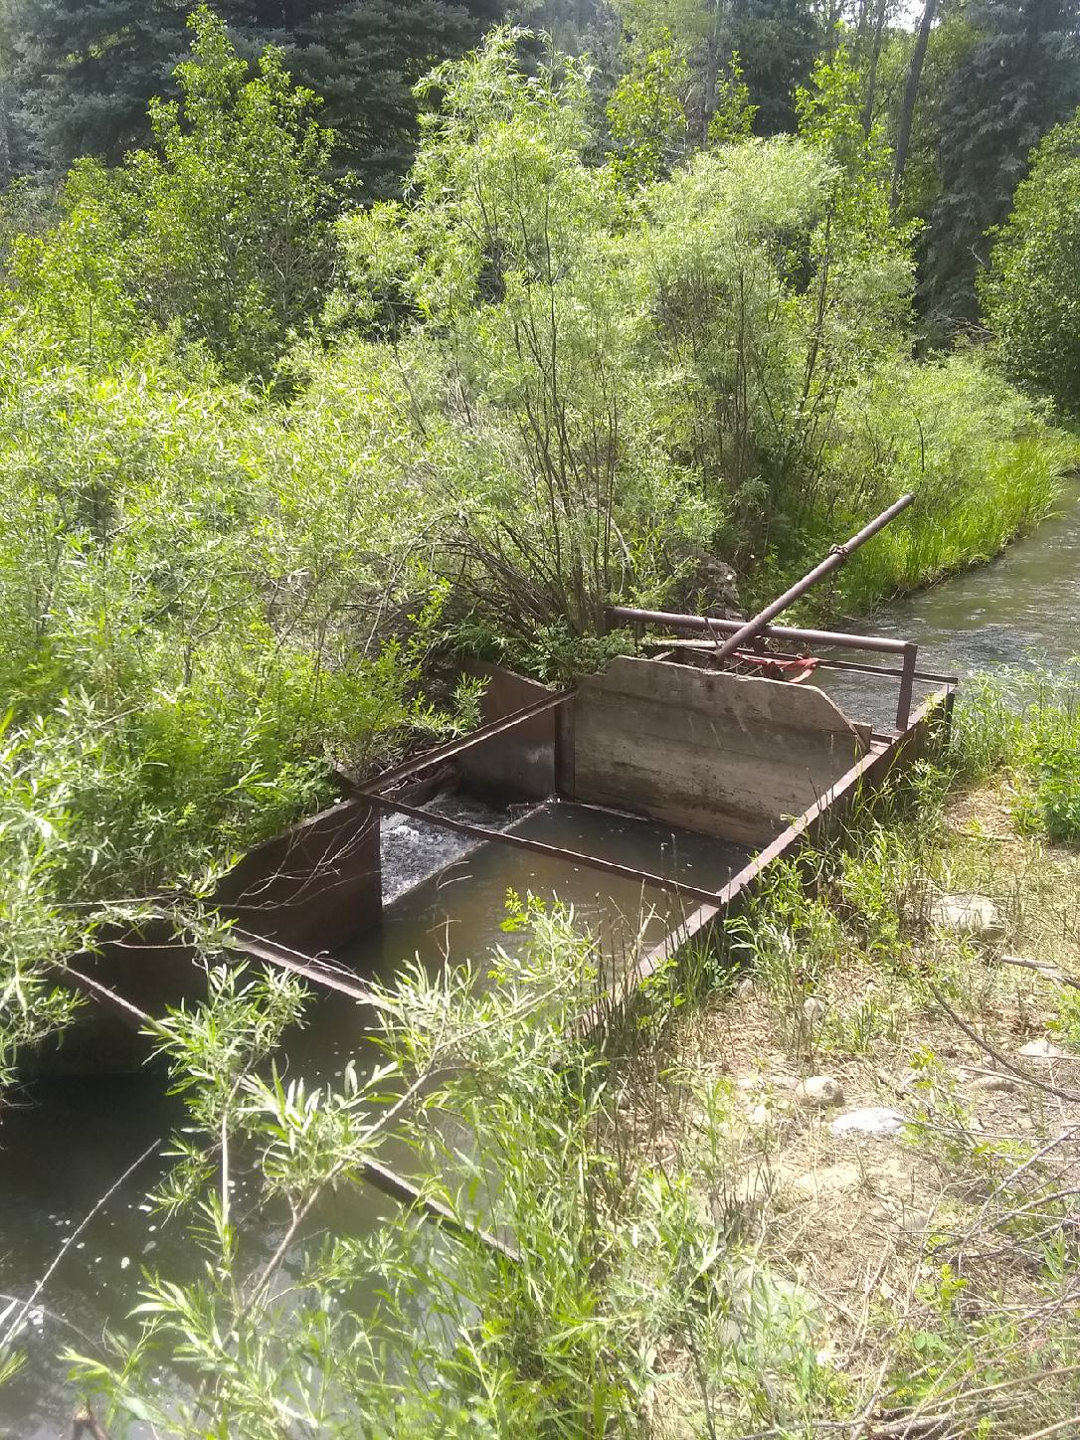
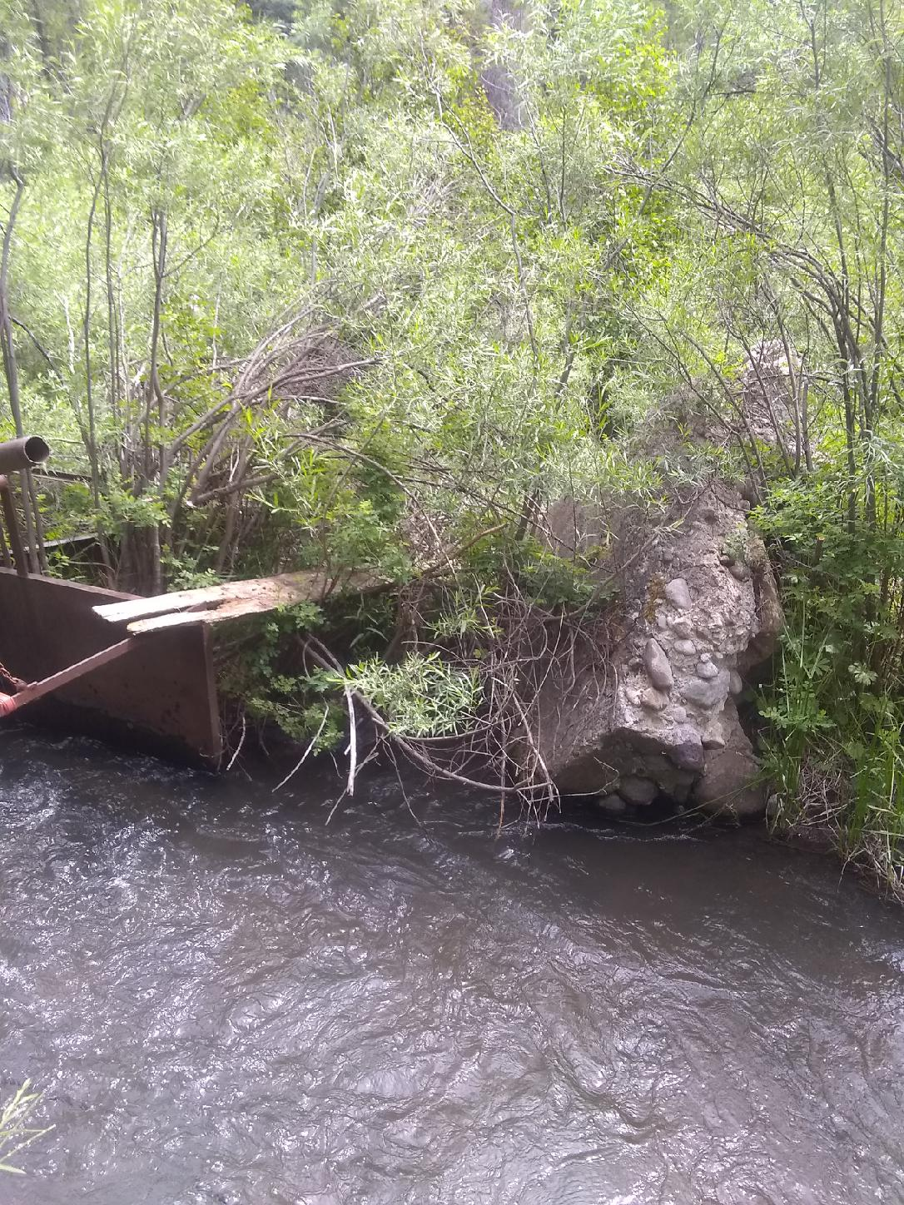
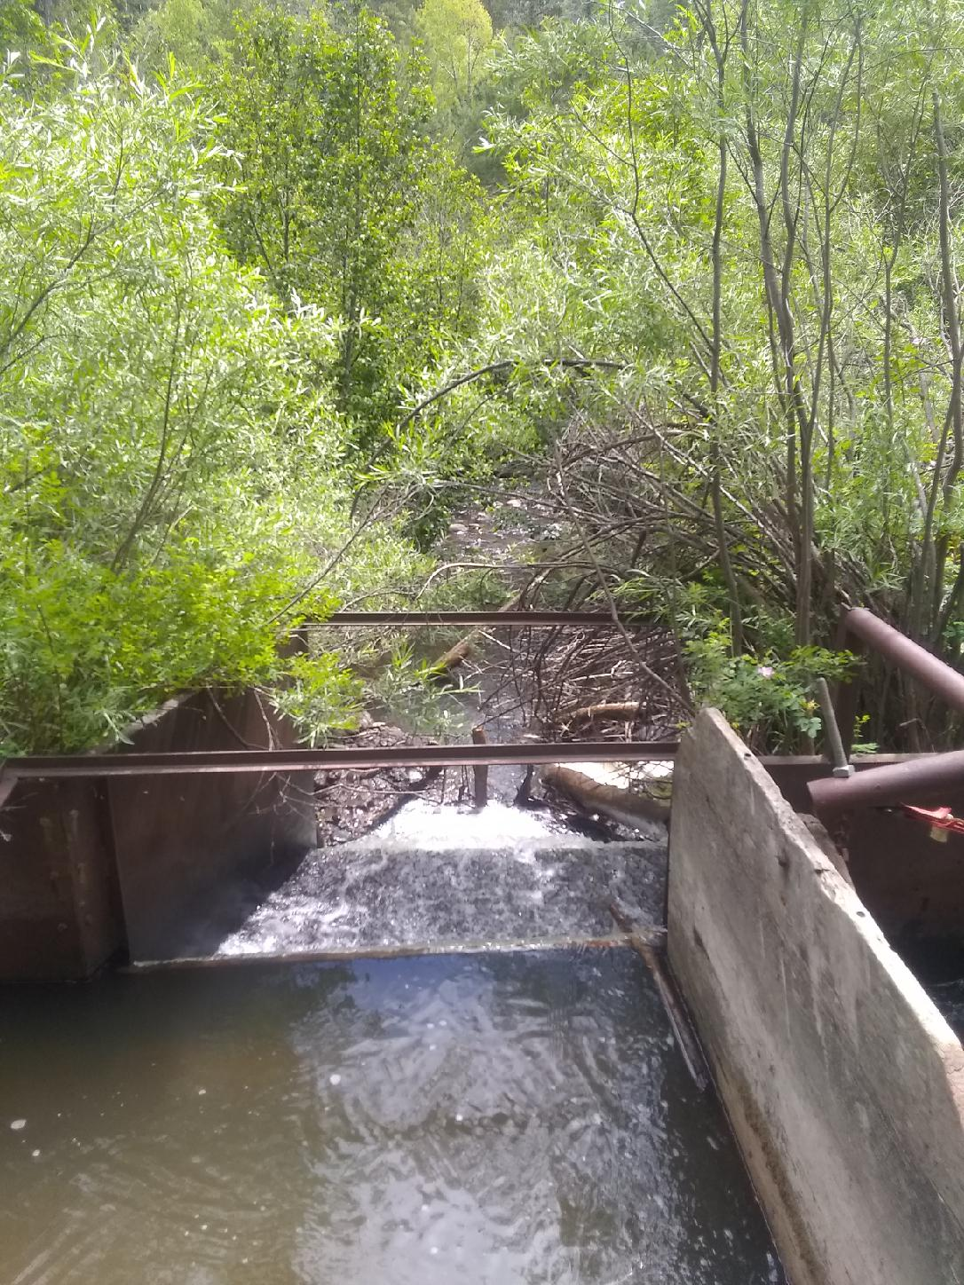
Division Box Photos
XX-2
XX-2_1
XX-2_2
XX-2_3
XX-2_4

Slide 6
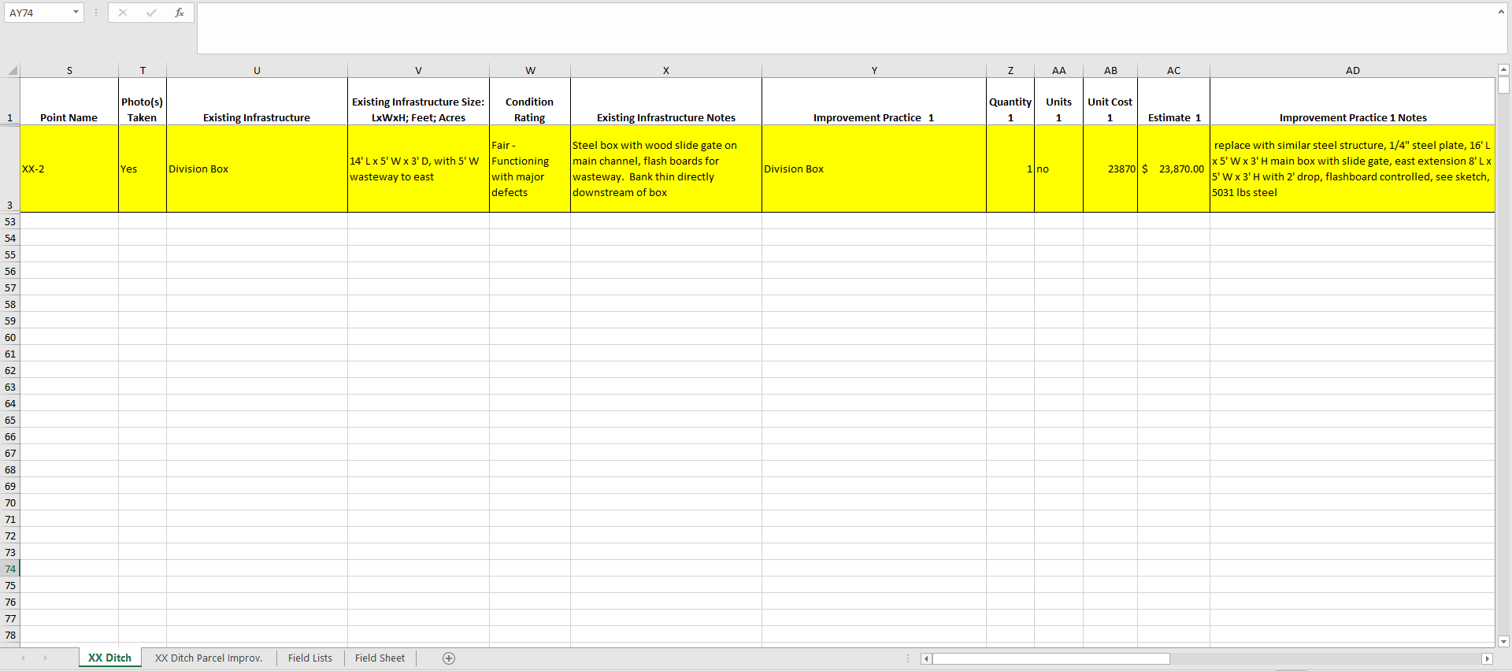

Slide 7
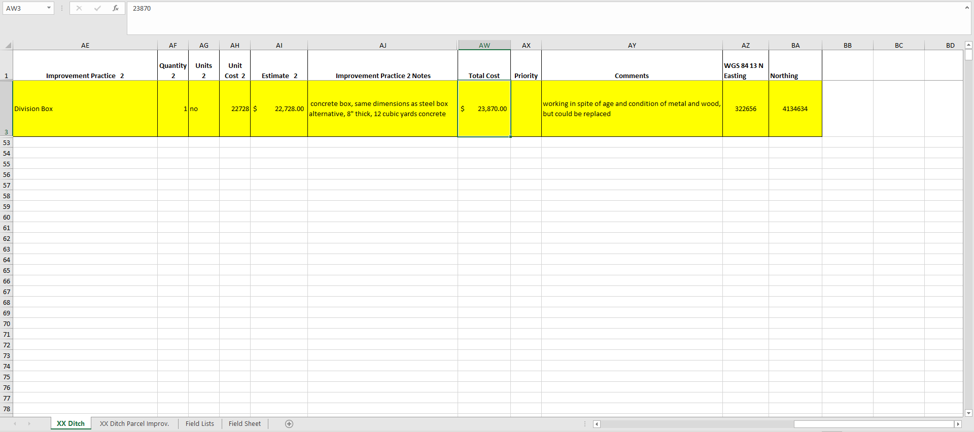

Slide 8
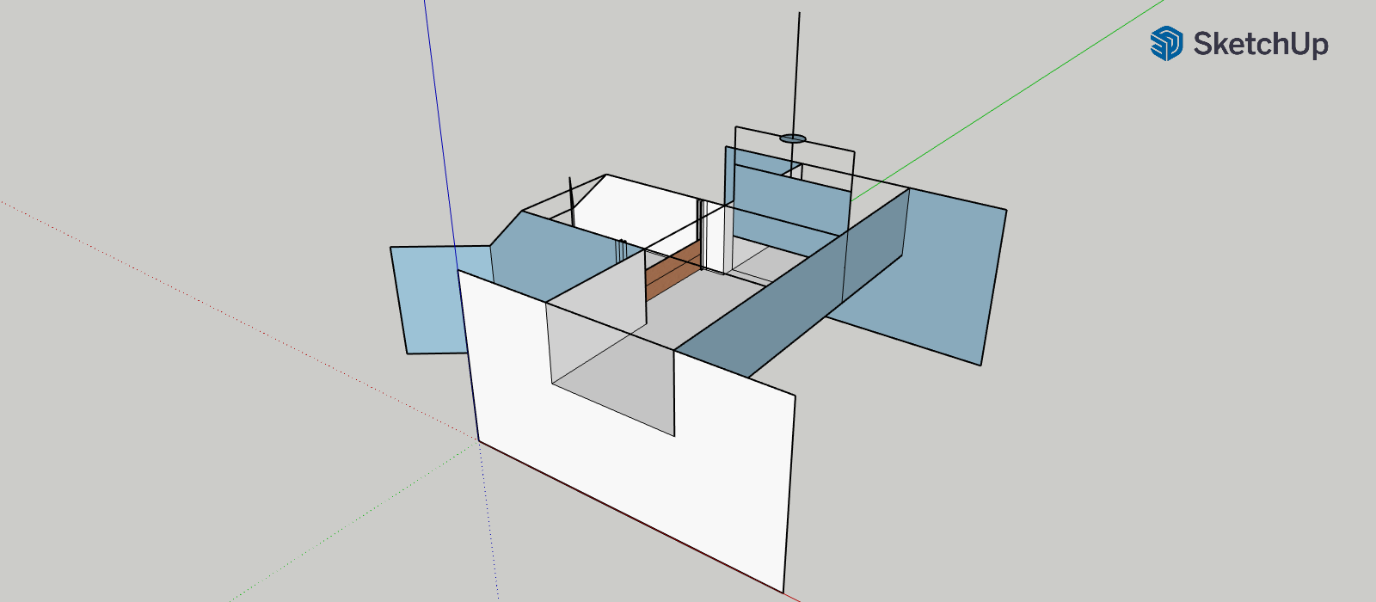
XX-2 Division Box Design

Slide 9
Ditch | Estimate
Snowball | $ 1,141,120.98
Mesa | $ 1,028,709.10
Four Mile | $ 1,007,938.80
Echo South/SW | $ 818,085.90
Highline | $ 603,220.00
Park | $ 390,401.82
Snook | $ 99,540.00
Snowball West | $ 86,474.80
Earl Adams | $ 62,127.20
Park West | $ 60,084.10
Colton Montroy | $ 46,226.00
Valley View/West | $ 38,239.62
Dutton | $ 30,591.20
Hershey | $ 16,528.00
Mesa East | $ 12,072.40
Horse Gulch | $ 7,041.44
Echo Ditch North | $ 6,923.00
Snowball Southwest | $ 6,834.30
Earl Adams West | $ 5,829.52
Hidden Valley | $ 2,222.00
Snowball South | $ -
Total Estimate | $ 5,470,210.18

Slide 10
Title and Content Layout with Chart

Slide 11
Approximate # of Irrigators – Total: 160 consisting of 322 irrigated fields (5,374 total acres)
Irrigation Method Acreage Percent Efficiency
Ditch 4,664 acres 30%-50%
Gated Pipe 683 acres 50%-60%
Sprinkler 27 acres 70%-75%
On Farm Irrigation Improvements (OFI) | Estimate
Echo OFI | $ 795,011.20
Four Mile OFI | $ 611,684.00
Mesa OFI | $ 549,211.30
Colton Montroy OFI | $ 520,650.40
Snowball OFI | $ 302,808.90
Park OFI | $ 288,192.60
Park West OFI | $ 149,590.00
Dutton OFI | $ 100,819.45
Horse Gulch OFI | $ 14,271.60
Total Estimate | $ 3,332,239.45

Slide 12
 |  | Ditch Improvements |  | On Farm Improvements
TOTALS | $ 5,470,210.18 | $ 5,470,210.18 |  | $ 3,332,239.45
GRAND TOTAL FOR ALL IMPROVEMENTS |  |  |  | $ 8,802,449.63

Slide 13
Next Steps
Continue inventory process in Blanco Basin and Navajo River Basin (Phase 3)
Present inventory map and results to each ditch lead/representative and get feedback on their priorities vs inventory findings
Gauge interest in moving forward with installing improvement practices and what level of funding is needed from grants to accomplish their goals
Seek funding to implement improvements!

Slide 14
Alternatives to Consider
Tailor Improvement Project Requests to Grant Opportunities
Whole Ditch
Improvements on ditch proper with or without on-farm improvements
Highest Priorities within each Ditch
Structures rated poor or fair
Replace Headgates at Diversion Point on each Ditch
Improve Fish Passage or other environmental/recreational aspects

