Slide 1
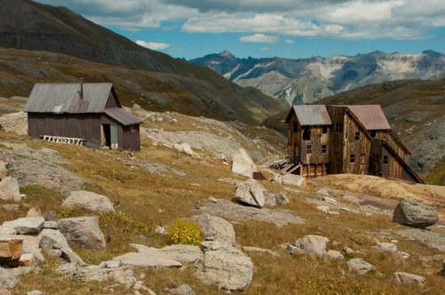
Welcome to the Fifth Annual San Juan Mining & Reclamation Conference “Evolution of Society, Mining & Reclamation”

Slide 2
San Juan Mining & Reclamation Conference Hosts [The Little Engine That Could]

Slide 3
San Juan Mining & Reclamation Conference Sponsors

Slide 4
House Keeping
Bathrooms
Cell Phones
Time Keeping / Singing Bowl
Break @ 10:15 – 10:45
Lunch @ 12:00 – 1:30
Village Table – Count?
Exhibits
Donations
Evaluation &Matching Contribution Forms

Slide 5
Courtesy Matters
Keep an Open Mind
Respect Different Perspectives
Listen Quietly - Move Conversations outside
Q&A at end of Presentations
Keep on Time – after breaks & lunch

Slide 6
Panel Discussion
How does your organization’s mission relate to the future of mining, reclamation, energy fuels?
How do society’s needs fit into this perspective on a local and global level?

Slide 7
Panel Discussion
How is your organization planning for the future: succession and needs of the next generation?
What tools or technology are going to help you achieve success in carrying out your mission?

Slide 8
Panel Discussion
What legacy do you want to leave?

Slide 9
Thank You
Evaluation Forms
Matching Contributions Forms
Donations
Sponsors

