Slide 1
Cleanup of Uranium Legacy in Southeastern Utah
Donald Metzler
Federal Project Director
San Juan Mining and Reclamation Conference
May 29, 2015

Slide 2
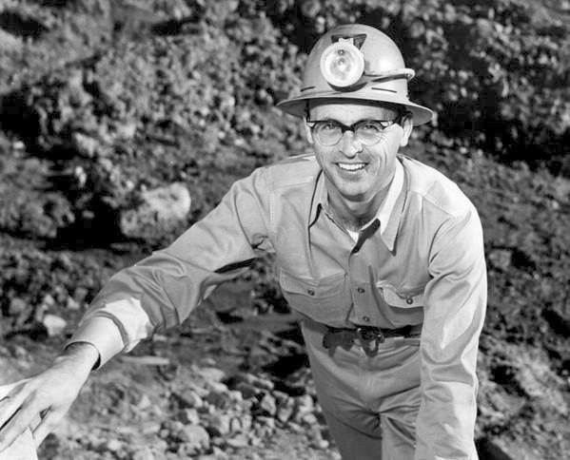
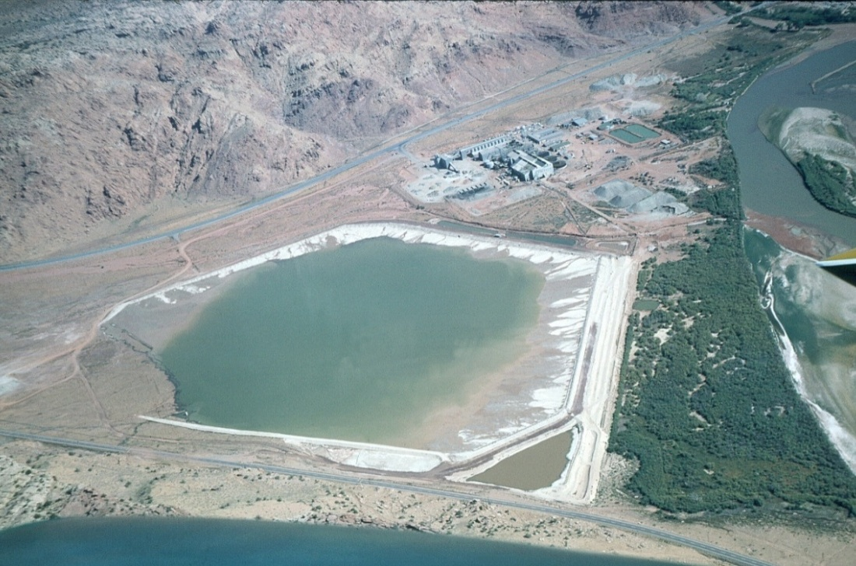
Moab Site Background and History
Charlie Steen’s fabled 1952 uranium discovery in Utah
Uranium Reduction Company began mill operations in 1956
Atlas Minerals Corporation acquired site and operated from 1962 to1984
Atlas filed for bankruptcy in 1998
Circa 1966

Slide 3
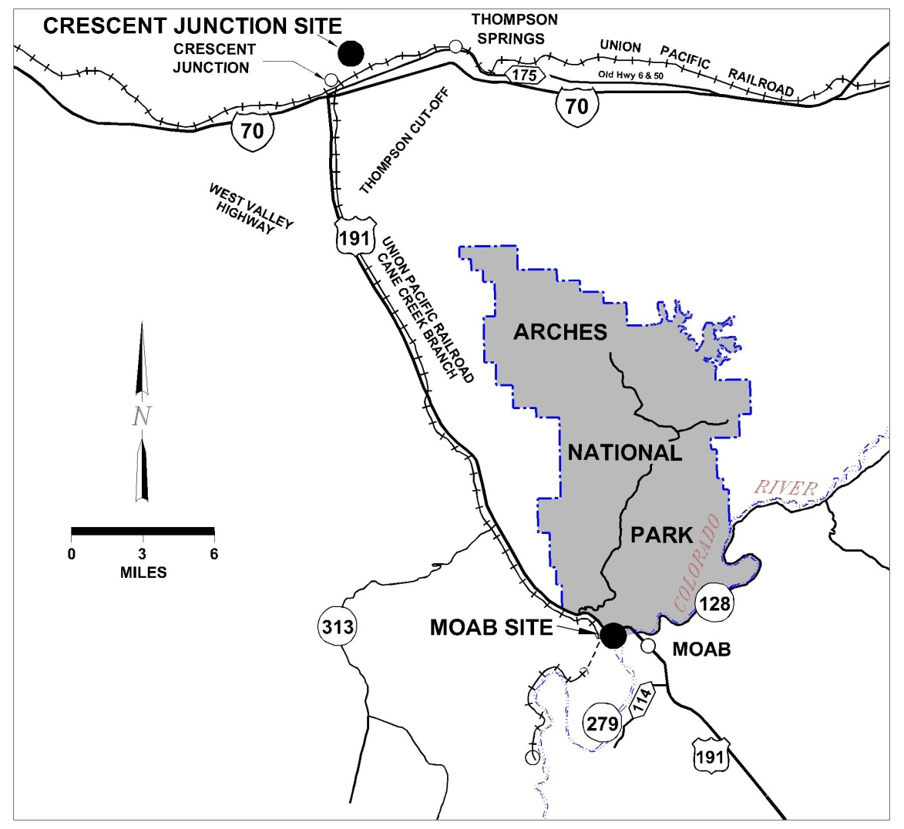
Moab Site Background and History (cont.)
Located about 3 miles northwest of Moab, Utah
480-acre site; 130 acres covered by uranium mill tailings pile
Largest uranium mill tailings pile (16 million tons) to be relocated in the world
Toe of pile is 750 feet from west bank of Colorado River

Slide 4
Regulatory Setting
Awareness of potential health risks associated with long-term exposure to uranium mill tailings grew during 1970s
Led to passage of Uranium Mill Tailings Radiation Control Act (UMTRCA) of 1978 (Public Law 95–604), requiring cleanup of inactive uranium-ore processing sites
In 1983, EPA developed regulations in 40 CFR Part 192 to protect public and environment from potential hazards at sites
DOE is responsible for cleaning up UMTRCA Title I millsites, including soils and groundwater, to EPA standards
Ownership of Moab millsite transferred to DOE in 2001; DOE responsible for site cleanup and reclamation
Moab Uranium Mill Tailings Remedial Action Project
Radioactive materials are encapsulated in U.S. Nuclear Regulatory Commission (NRC)-accepted disposal cells

Slide 5
Project Scope
DOE issued Environmental Impact Statement and Record of Decision in 2005
Relocate uranium mill tailings and other contaminated materials from Moab site to the Crescent Junction, Utah, location for permanent disposal
Predominantly by rail
Actively remediate groundwater at the Moab site
Remediate properties in vicinity of Moab that exceed EPA standards for radium-226 in soil

Slide 6
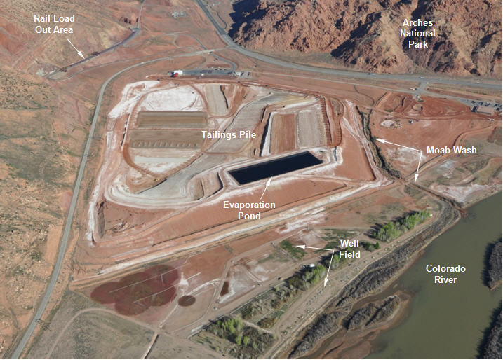
Moab Site Features

Slide 7
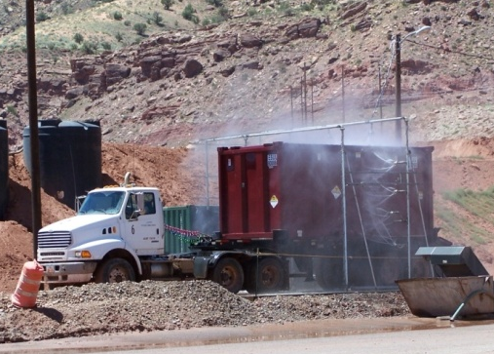
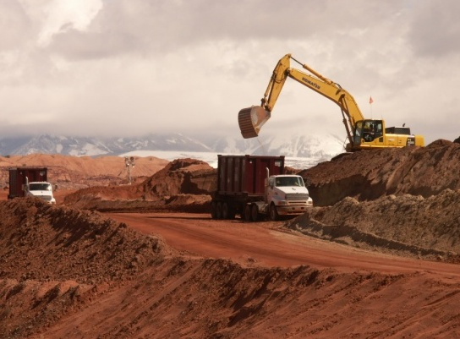
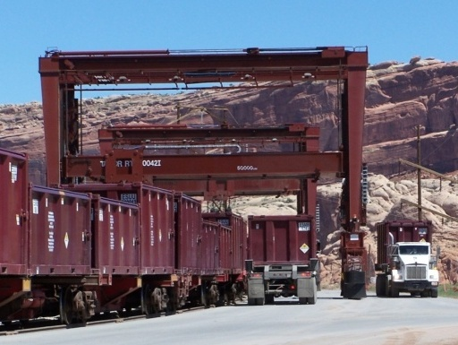
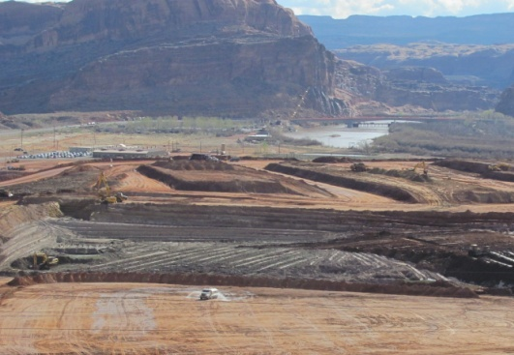
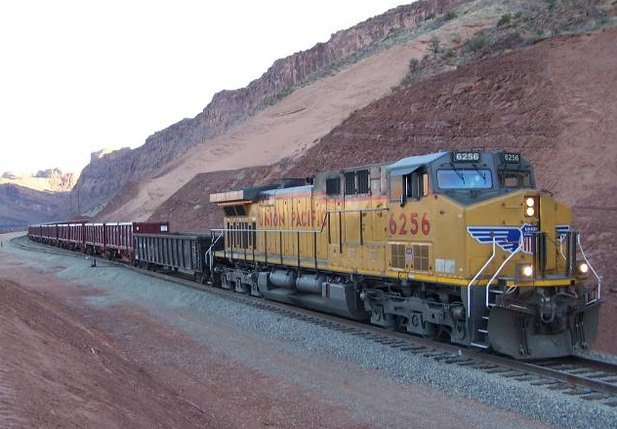
2
3
Process Cycle
Moab
1
4
5
Notes:
(Upper left photo of pile) Tailings are excavated from their position in the tailings pile.
Conditioned by mixing sands and slimes, then disking until optimal moisture content is achieved (16 to 18%), and top-loaded into containers.
Loaded container is weighed on a certified scale, then driven through lidding facility to receive lid.
Truck carrying container moves through wash facility.
Container placed on survey rack for visual inspection and radiological release.
“Clean” haul truck takes full container up haul road to rail load out where it’s loaded on the train with a gantry crane. Two shifts per day, “done at 1:00” to support rail haul.
Full containers transported by rail to Crescent Junction.
Reach stacker removes container from train, places on articulated truck, where it is transported to the disposal cell.
Tailings dumped through hinged end gate. Gate closed, container and truck decontaminated, and truck returns empty container to rail spur.
Tailings are compacted in the cell using a sheep’s foot.
At end of shift, empty containers are returned by rail to Moab.

Slide 8
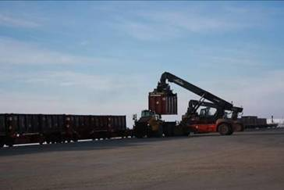
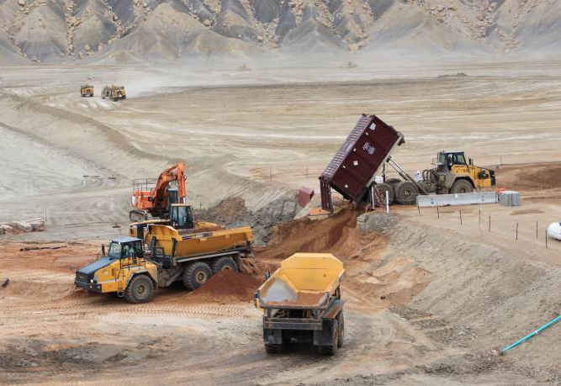
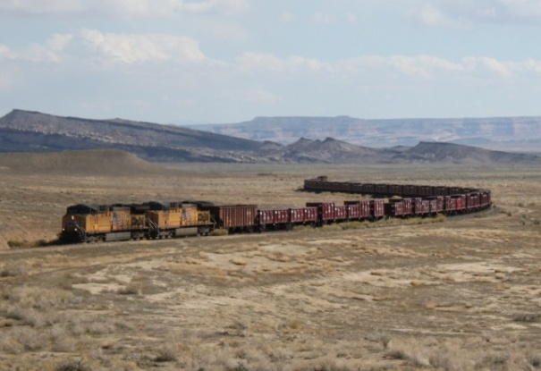
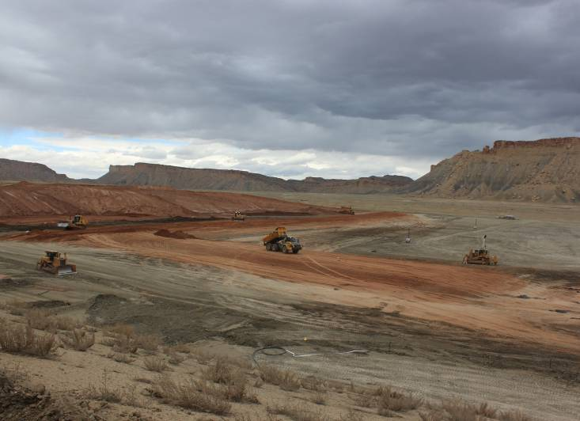
1
Process Cycle Crescent Junction
2
4
3

Slide 9
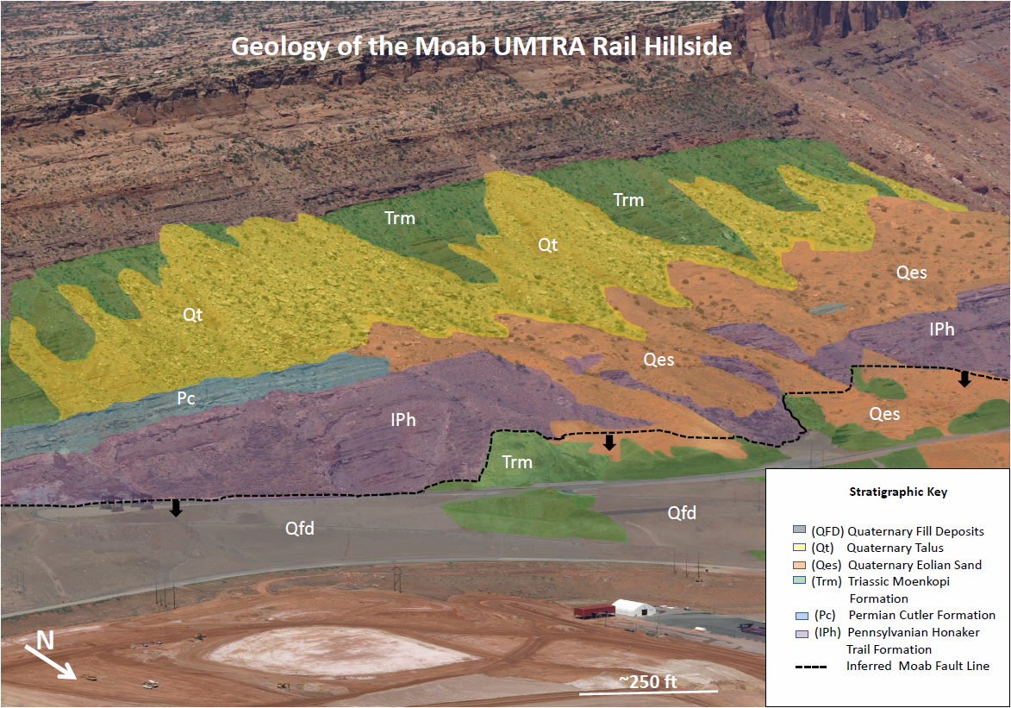
Rail Bench

Slide 10
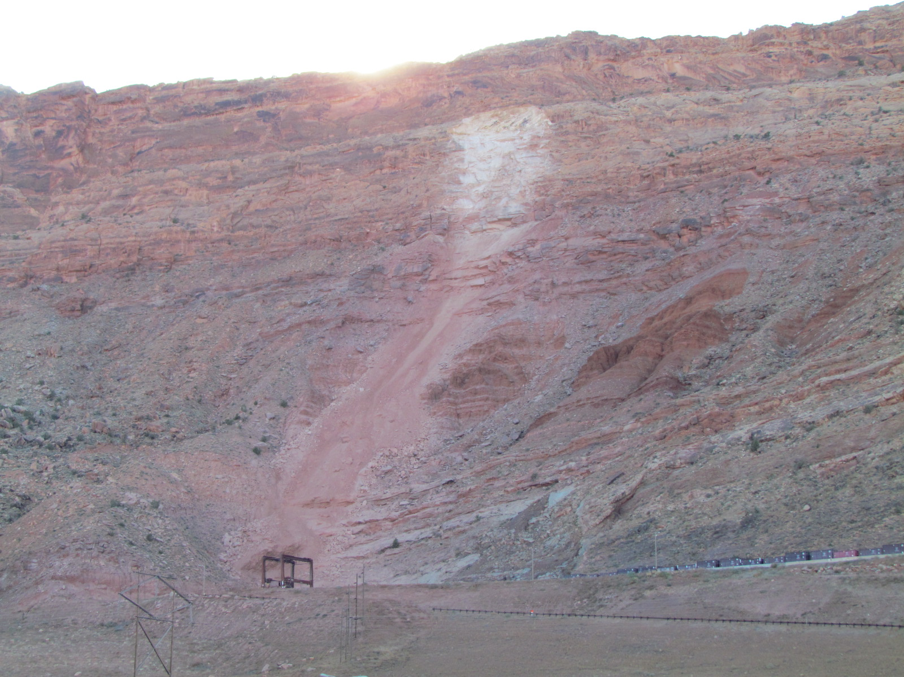
November 2014 Rockslide

Slide 11
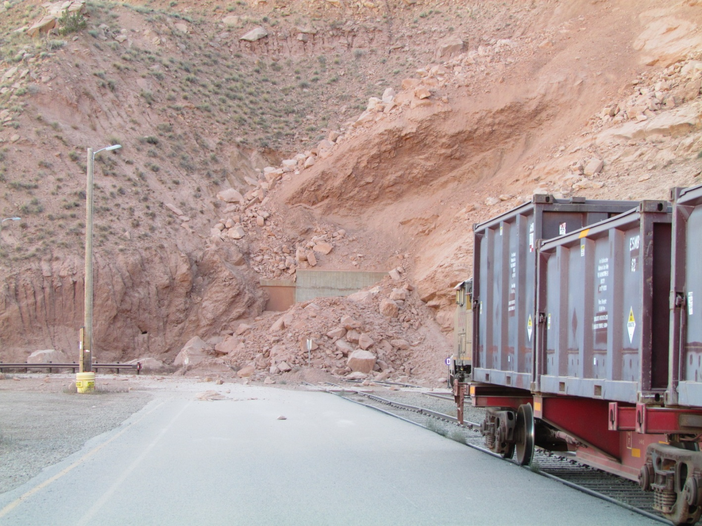
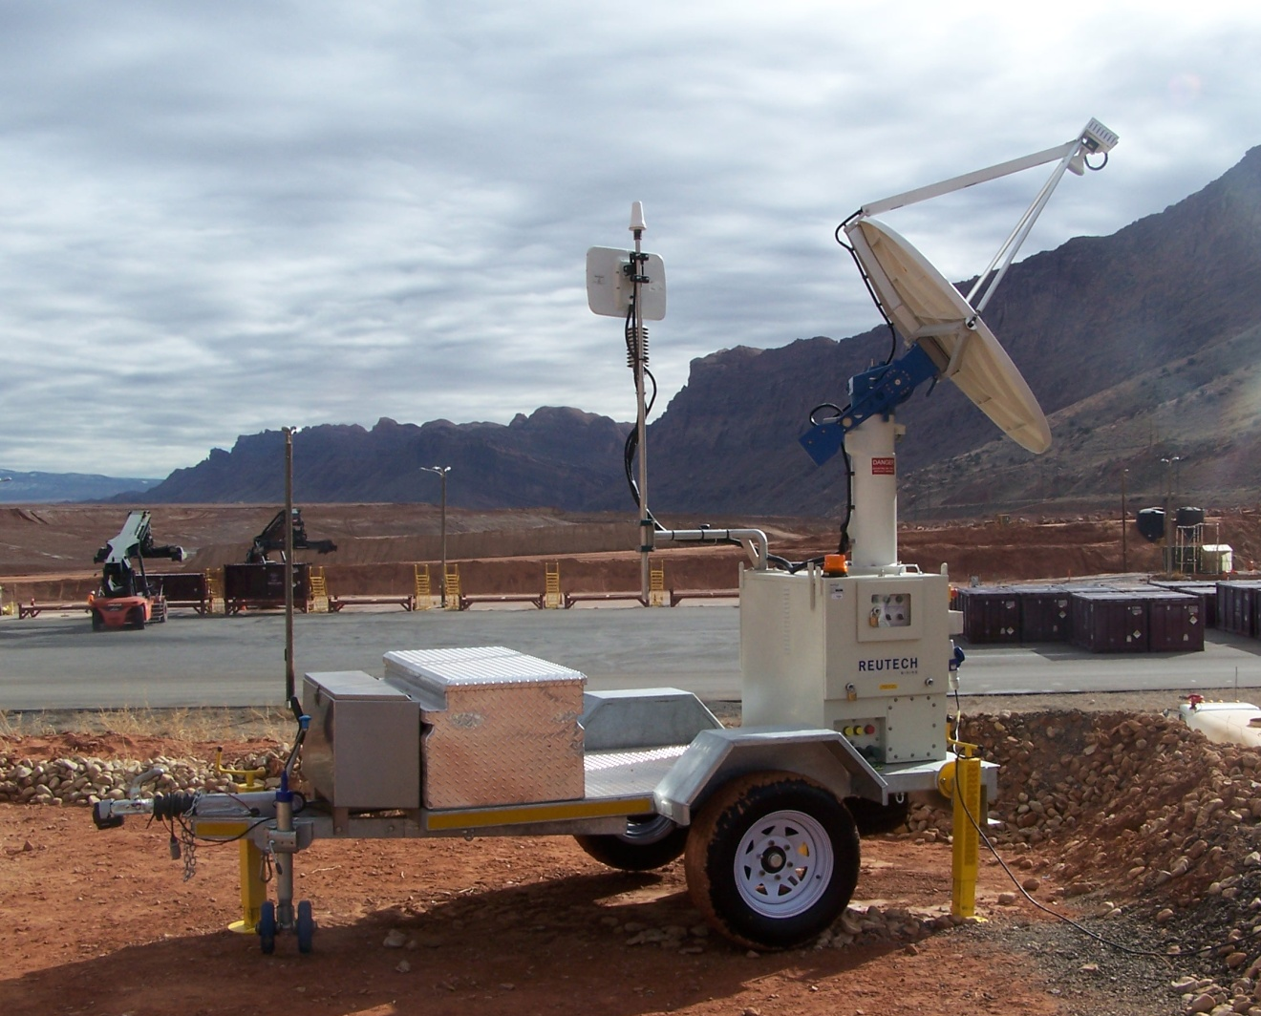
Rockslide (continued)
No injuries
4,500 cubic yards of material
Risk analyses
Installed radar monitoring unit
Phased approach to restarting rail operations

Slide 12
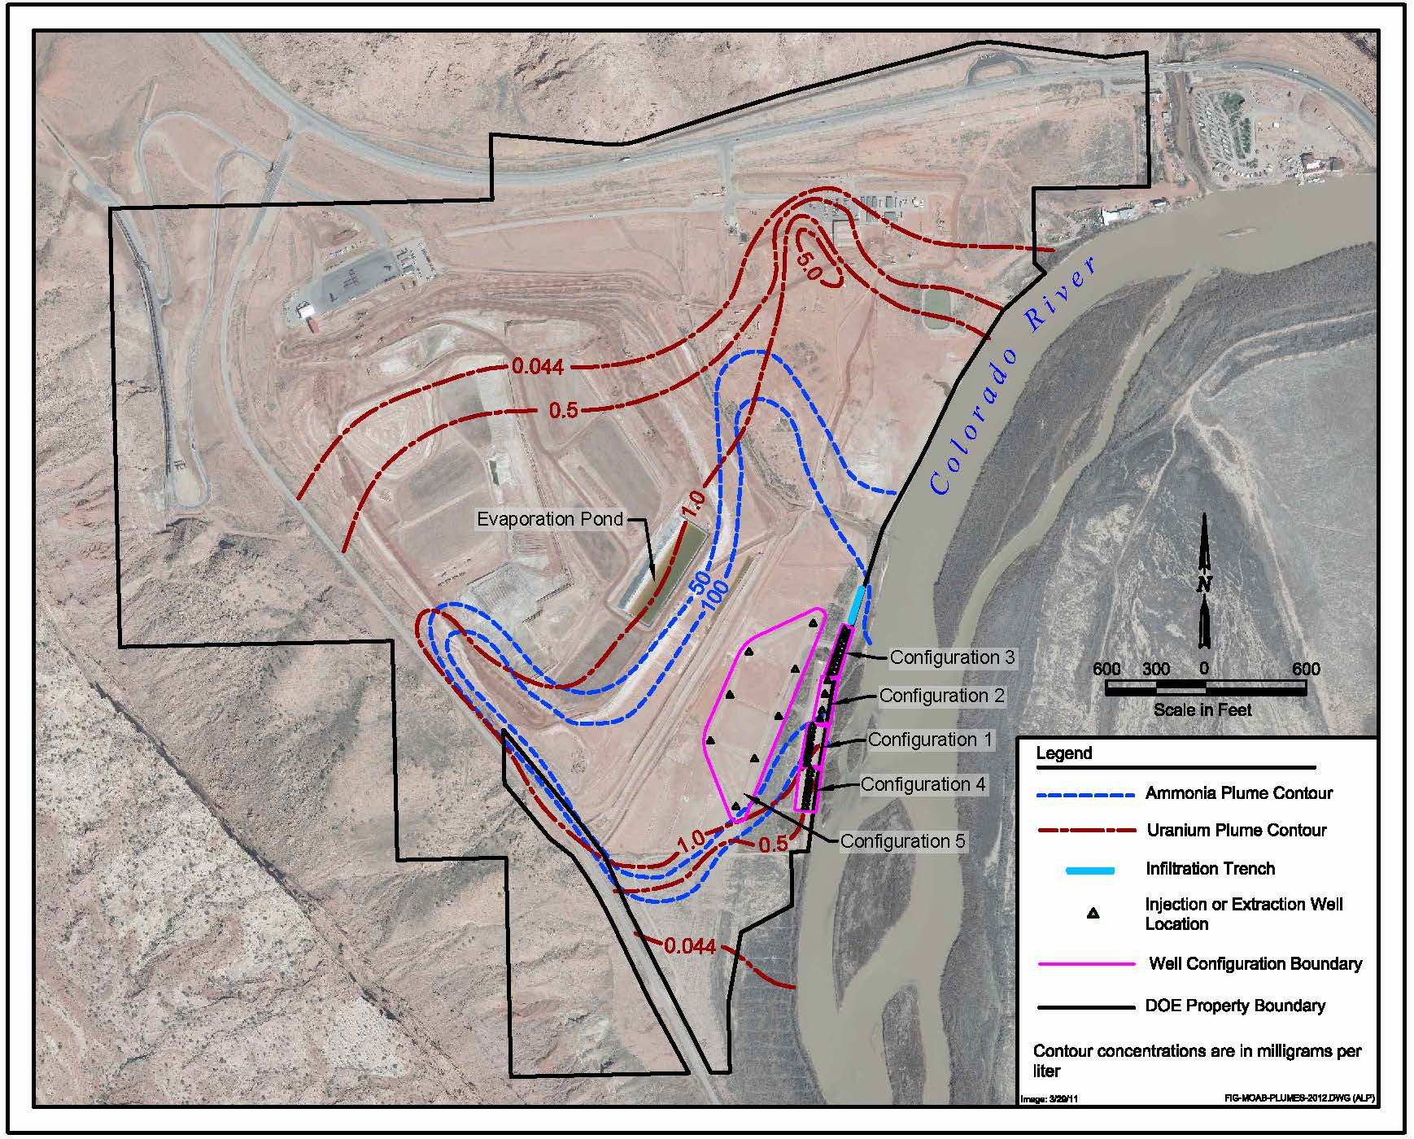
Groundwater Plumes

Slide 13
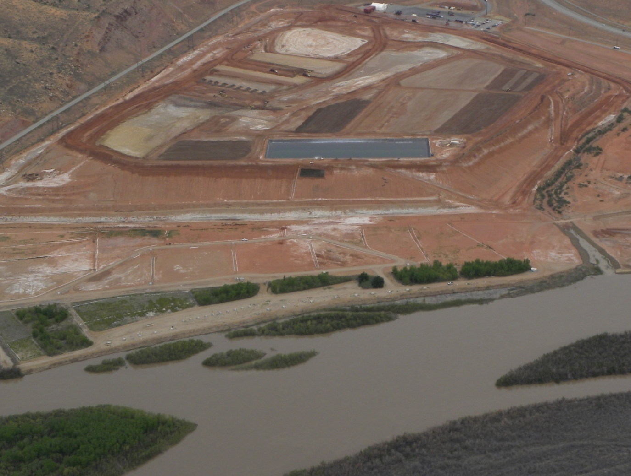
Groundwater Interim Action and Surface Water Diversion
Addresses elevated ammonia and uranium levels to protect side channels that can become suitable habitat
Extract groundwater from eight wells closer to toe of tailings pile
221 million gallons extracted, including 846,000 lb of ammonia and 4,350 lb of uranium
Evaporation used to eliminate extracted water
Inject freshwater into wells along riverbank to create hydraulic barrier
Divert surface water into side channels
Extent of Tailings Pile
Evaporation Pond
Groundwater Extraction
Freshwater Injection
Surface Water Diversion
Notes:
Interim Action well field primarily designed for ammonia removal
8 Extraction Wells
34 Fresh Water Injection Wells
107 Monitoring Wells (various screened intervals).
42 River Bed Well Points

Slide 14
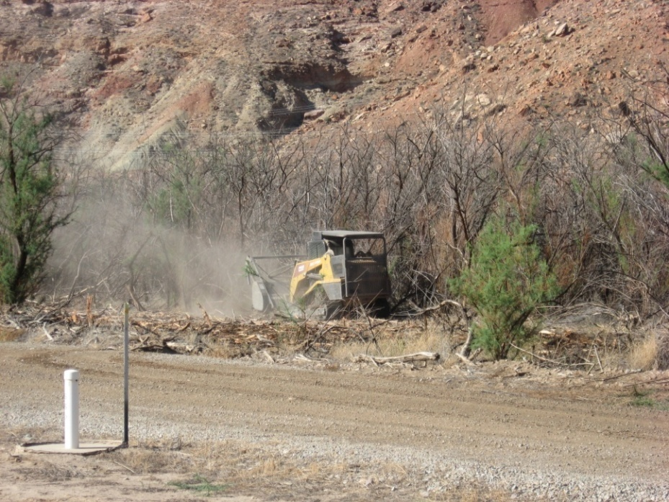
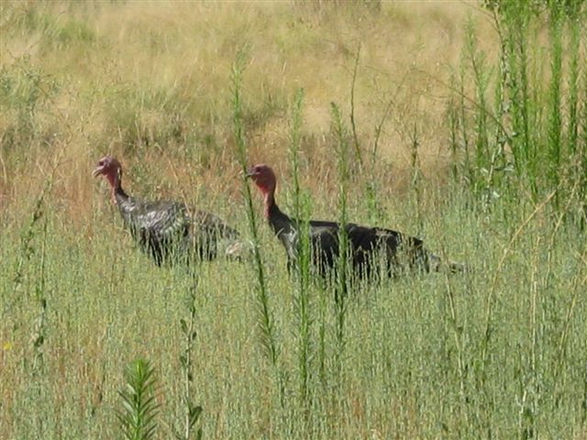
Current Activities with Future in Mind
Tamarisk removal
Near groundwater well field
Erosion control
Along hillside up to rail load out area
To assist with storm runoff from U.S. Highway 191 and Moab Wash
Revegetation of disturbed areas with native species
Notes:
Fauna study: Initial assessment to identify species currently using Moab site
Develop habitat model for land use planning and to mitigate habitat loss

Slide 15
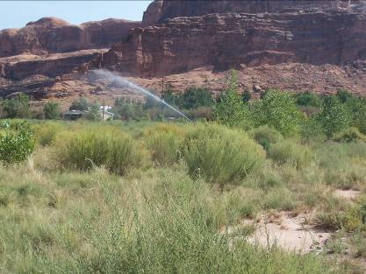
End State Vision
Land ownership and use
DOE will transfer ownership at completion of cleanup
Water rights on Colorado River ―Could be sold separately
Want to leave in a park-like setting
Mill Tailings Project Future Use Committee
Acting as quasi-reuse organization to represent community’s interests
Conducted public input process last year and prepared community vision
Coordination with other federal agencies
Possible land transfer mechanisms and infrastructure and facilities disposition
Notes:
Other federal agencies: National Park Service and Bureau of Land Management

Slide 16
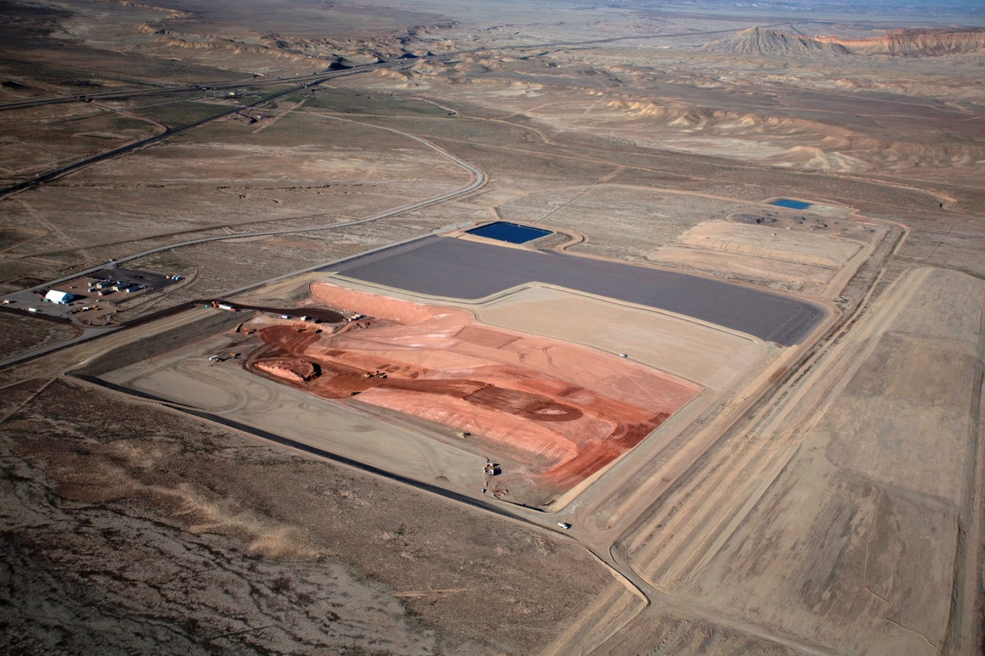
Crescent Junction Disposal Site
Cell aligned in a west-to-east direction, about 5,200 feet long by 2,400 feet wide
Cell excavated in phases; two phases (~ 45 acres each) have been completed
Tailings depth is 50 feet total, 25 feet below grade, 25 feet above
10-foot-thick, multi-layer cover

Slide 17
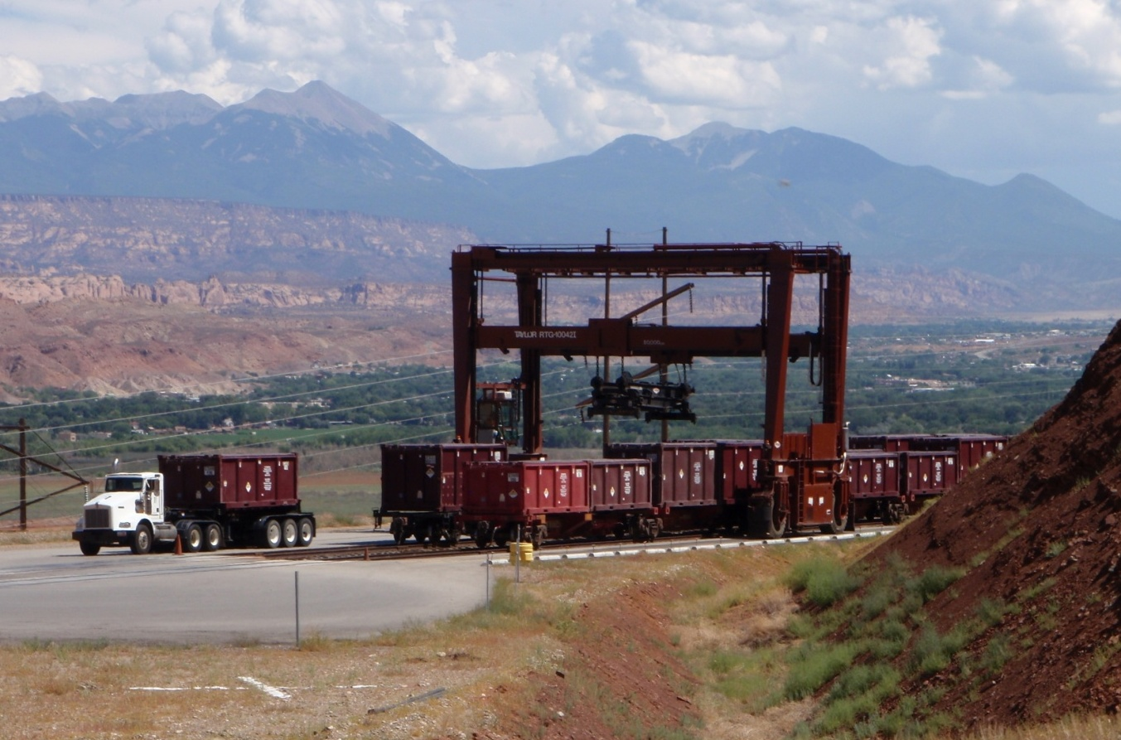
Status
Currently shipping 104 containers per train, one train per day, Monday through Thursday
Through mid-May 2015, about 7.5 million tons of mill tailings (47 percent of total) has been shipped and disposed

Slide 18
Importance of Safety
Early on in project, safety luncheons held at work sites with safety awards presented
Contractor Safety Committee created
Effect on safety of employment influx during American Recovery and Reinvestment Act
Safety Conscious Work Environment, or SCWE, that encourages employees to raise safety concerns to management without fear of retaliation, through:
Employee safety questionnaires
Worker engagement
Employee Concerns Program
2.3 million safe work hours as of May
Days Away from Work, Restricted, and Transferred and Total Recordable Case rates are at zero

Slide 19
Moab Project Information
gjem.energy.gov/moab

Slide 20
Questions?

