Slide 1
UpPER SAN JUAN WATERSHED ENHANCEMENT PARTNERSHIP
Exploring opportunities to secure resilient water resources for all users

Slide 2
Structure
Phase I updates
Requests
Concept Design Proposal

Slide 3
Overview
Unique approach: Phase I focused on stakeholder engagement and community-led process
Diverse & Committed Steering committee representation composed of ranch managers, outdoor recreation businesses, ditch company members, municipal water providers, government agencies, education institutions, nonprofits, and local residents.

Slide 4
GOALS
Incorporate all values, voices, interests
1
Build community support, bring public into conversation
2
Build off community knowledge; incorporate community decision making
3
Advance a culture of stewardship
4
Respect history, current uses, water law
5
Optimize water resources for all uses in accordance with CO water law
6
Build a program around Science based adaptive management
7

Slide 5
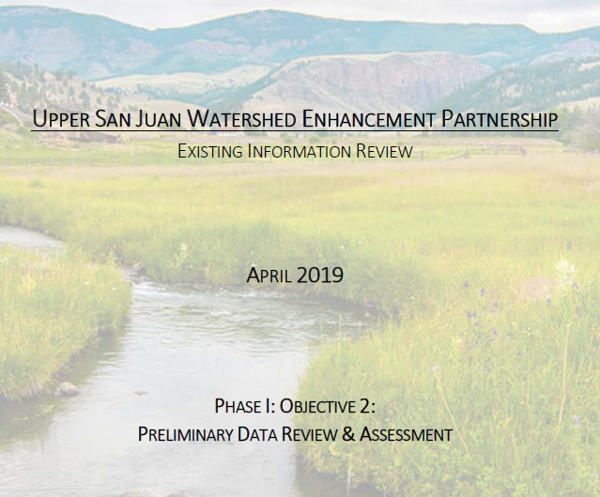
Objectives
Identify opportunities, potential project areas
Identify community interests
Measure community response
identify current data and data gaps
Public education - through articles, PSA’s, meetings, etc.
Guide technical review in Phase II
Map sensitive areas

Slide 6
2018-2019 Accomplishments so far
Established committed steering committee of diverse water users
Community feedback refined scope, concerns, opportunities, and information gaps
Compiled reports/data from local efforts to inform future assessment needs & priorities
Preliminary identification & mapping of project sites
Exploring opportunities to mutually benefit and protect water resources for environmental, agricultural, recreation, and municipal uses.
Convened 12 stakeholder meetings
Ongoing public outreach: online surveys, press releases, meetings, and field trips.

Slide 7
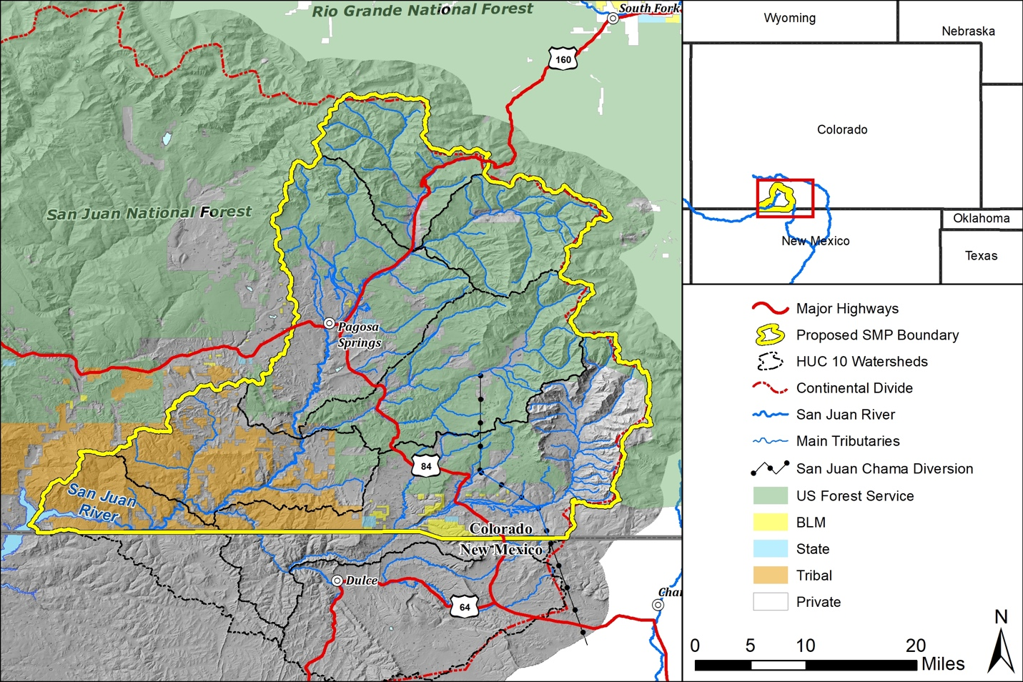
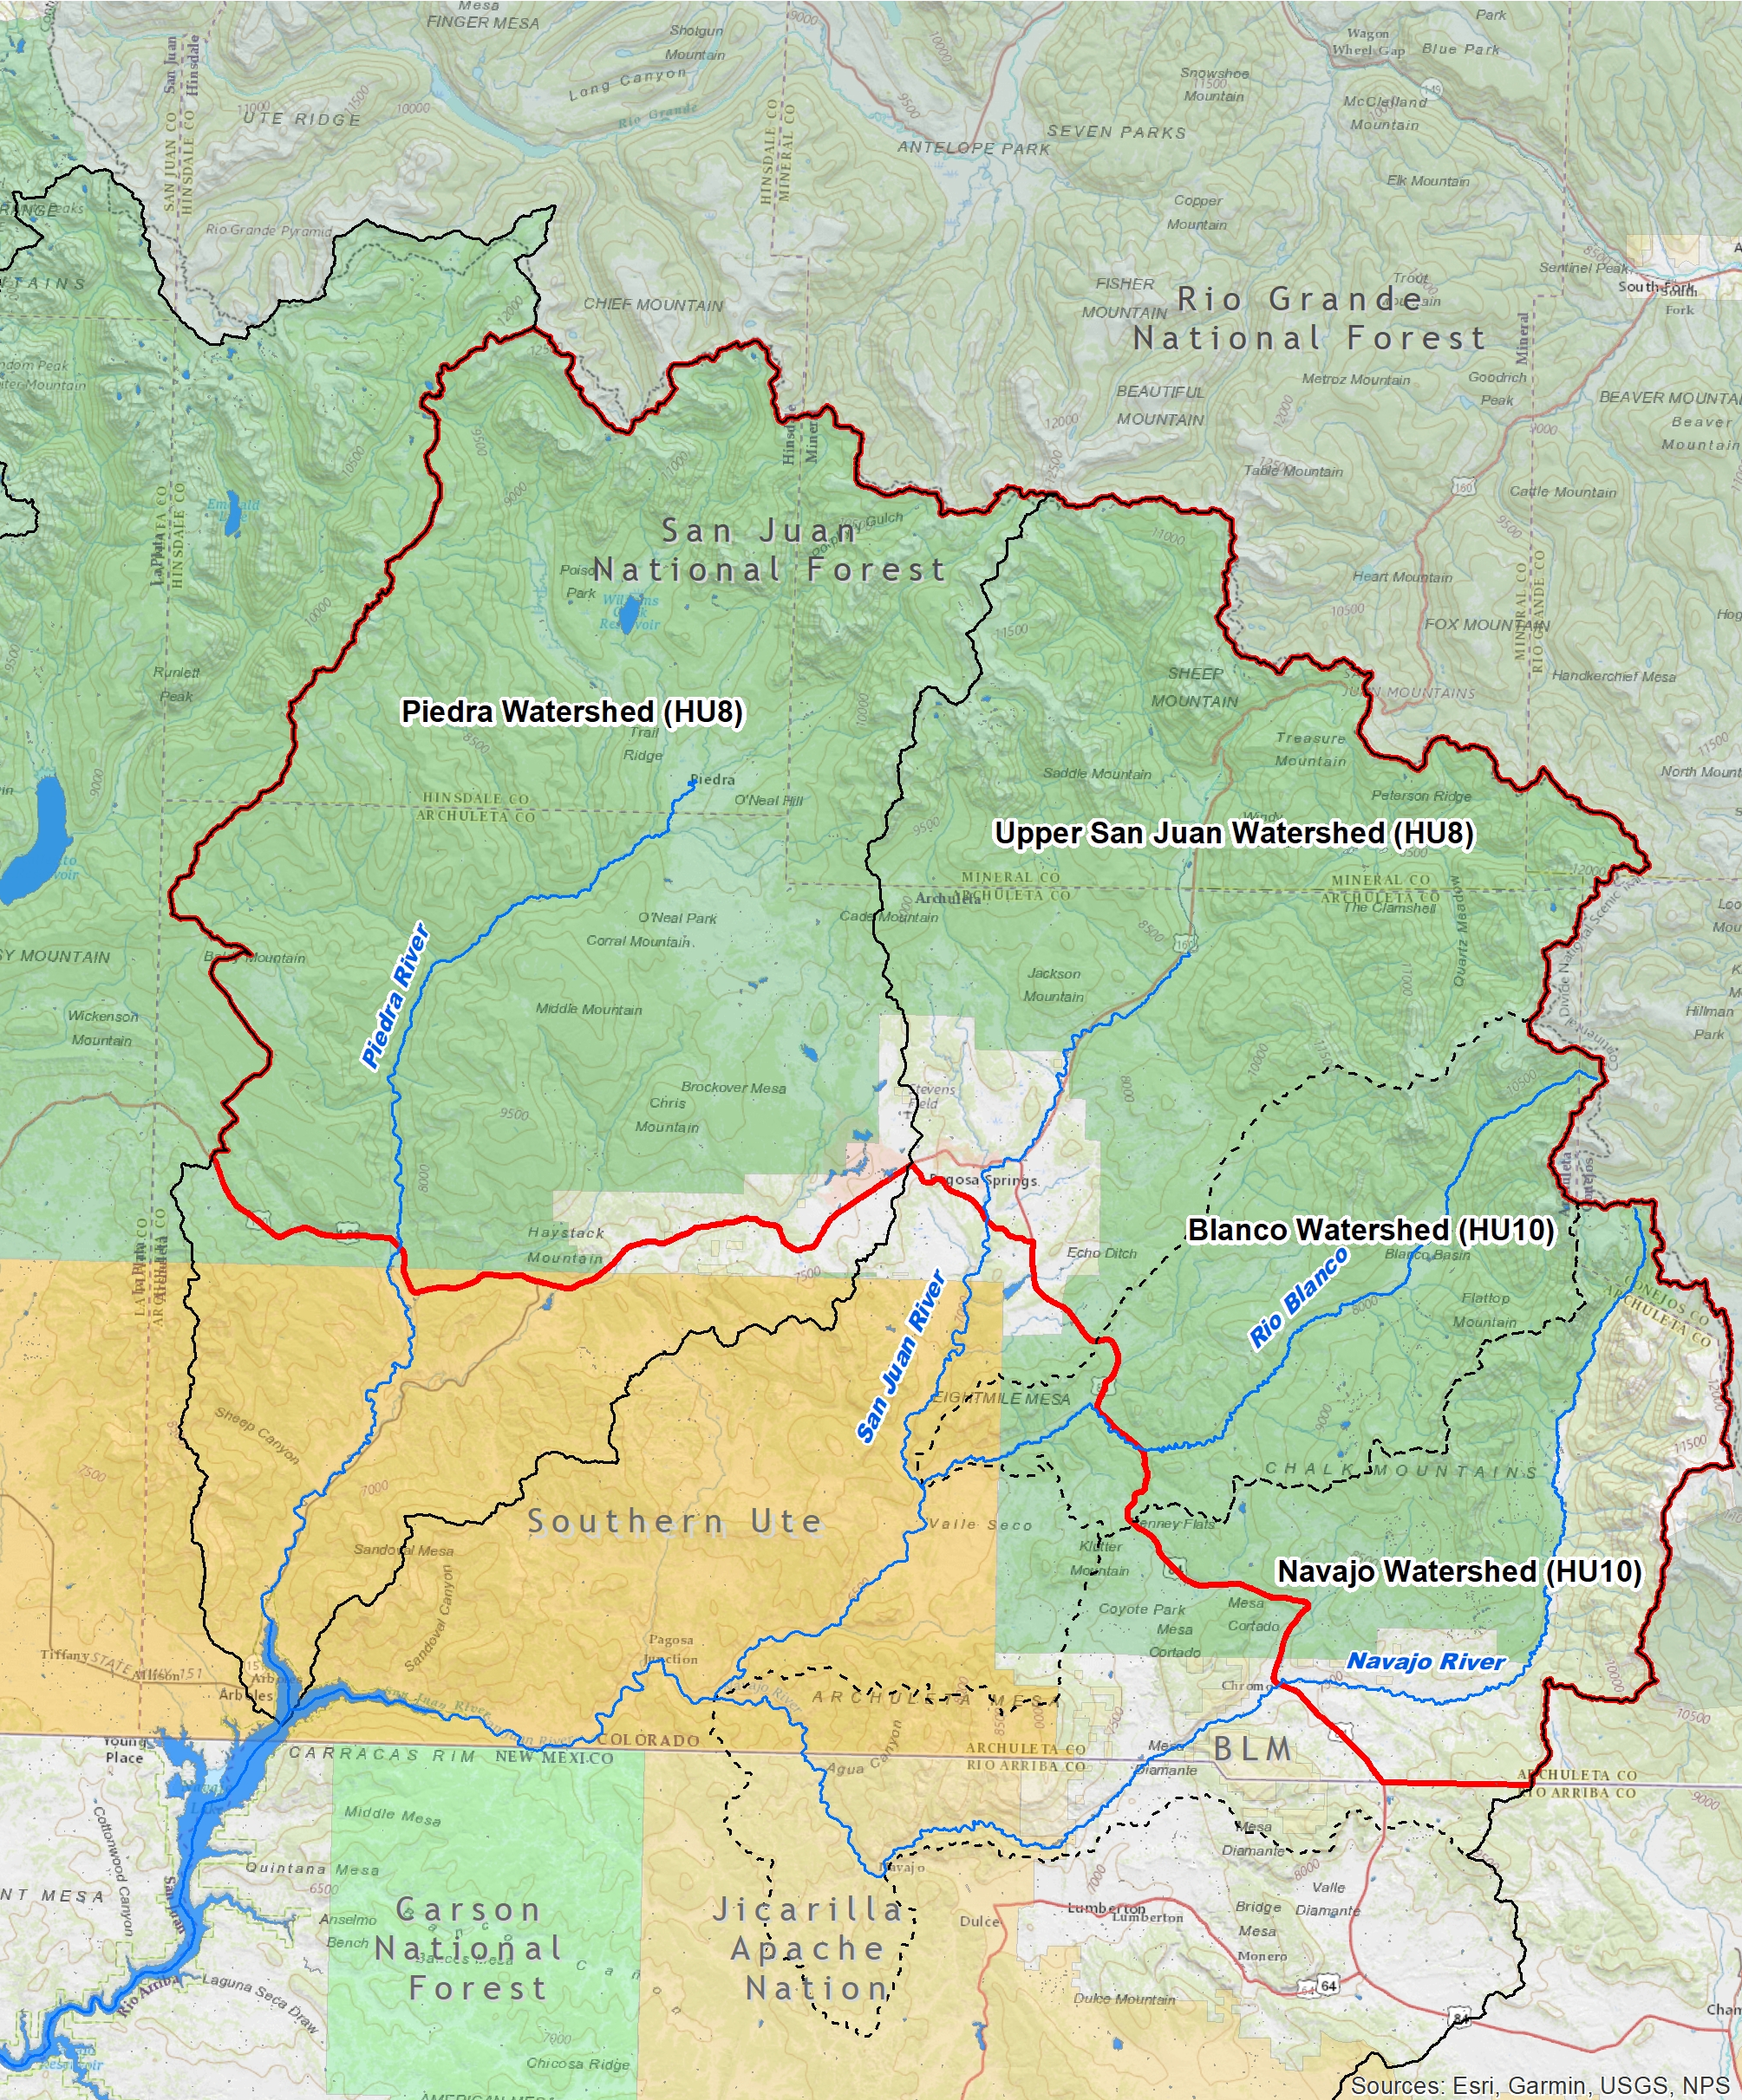
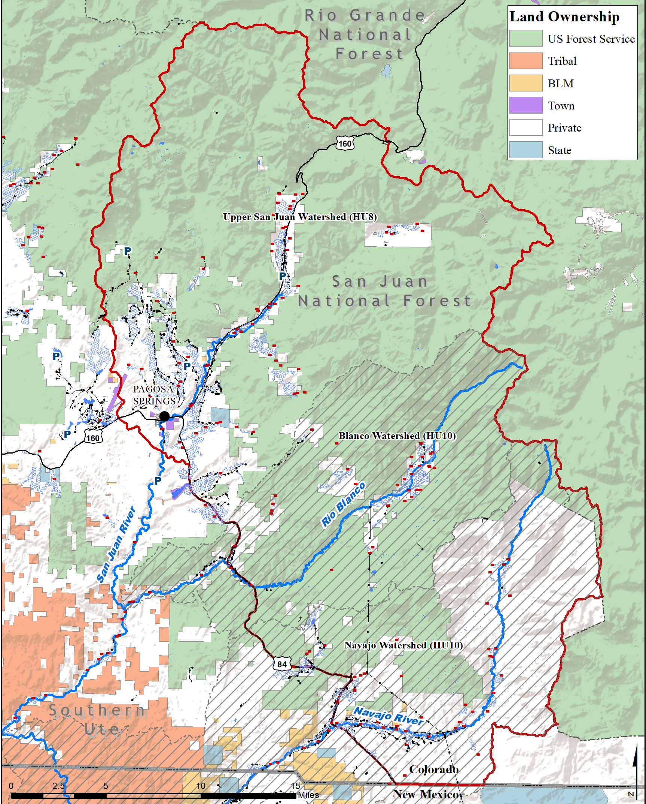
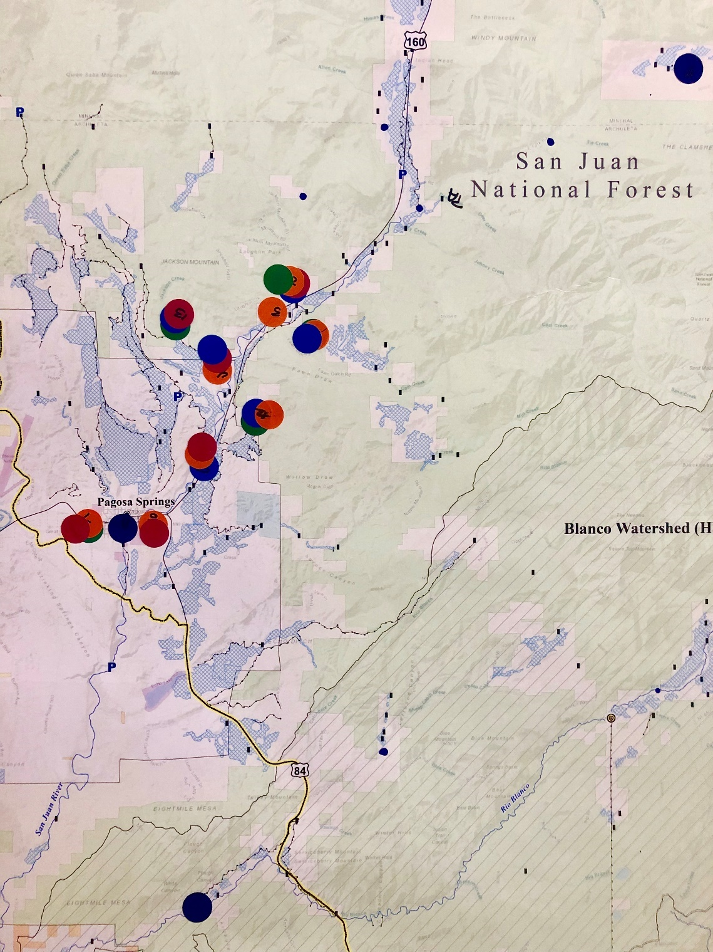
Locally driven & refined

Slide 8
Future trajectory
Concept design proposal → demonstration project
Complimentary to phase II watershed assessment
Phase II
Secure funding fall 2019/winter 2020
Broader Watershed assessment + site and/or project prioritization

Slide 9
Requests
$7,500 from SWBRT for concept design plan
Letter of support from SWBRT for phase II Grants

Slide 10
Concept Design Plan Proposal
design for multi-purpose project (agriculture, environmental, recreation & municipal)
refine design plan based on stakeholder feedback & approval
community interest and needs identified opportunity to begin analysis & project feasibility

Slide 11
Concept Design Plan Proposal
Accomplishes goal to find opportunities that benefit multiple water user groups, using local expertise and priorities
Potential to Demonstrate on-the-ground improvements gained from a stream/watershed management plan
Tasks & Deliverables:
Conduct field survey of project area locations of key project components
Conduct gauge data analysis for San Juan River
Assess general channel geomorphic conditions
Create base map of project site
Create concept design drawings, preliminary budget/cost estimate and brief narrative of improvement features

Slide 12
We appreciate our funders!
Colorado Water Conservation BOARD
San Juan Water Conservancy District
SOUTHWEST BASIN RoundTable
Southwest Water Conservation district
The Nature Conservancy
Trout Unlimited

